Slide 1

Modern Javascript ES6
INTRODUCTION

Slide 2
What is ES6? Why Should we use ES6?
Es6 stands for ECMAScript released in 2015.
ECMAScript is a base language for all scripting languages.
JavaScript ES6 brings new syntax and new awesome features to make your code more modern and more readable.
It allows you to write less code and do more.
ES6 introduces us to many great features like arrow functions, template strings, class destruction, Modules… and more.

Slide 3
New Features in ES6
The let keyword
The const keyword
Arrow Functions
For/of
Map Objects
Set Objects
Classes
Promises
Symbol
Default Parameters
Array.from()
Array keys()
Array find()
Array findIndex()
Object entries
JavaScript Modules
String.includes()
String.startsWith()
Function Rest Parameter

Slide 4
New Way of Declaring Variables www.jsbin.com for practice.
VAR
The keyword is used in all JavaScript code from 1995 to 2015.
LET
The keyword allows you to declare a variable with block scope..
CONST
Constants are similar to let variables, except that the value cannot be changed.

Slide 5

ARROW FUNCTION IN ES6
Arrow functions were introduced in ES6.
Arrow functions allow us to write shorter function syntax:
hello = () => "Hello World!";
ES5
ES6
var multiplyES5 = function(x, y) {
};
return x * y;
const multiplyES6 = (x, y) => {
return x * y
};

Slide 6
ARROW FUNCTION WITH “THIS” KEYWORD

Slide 7
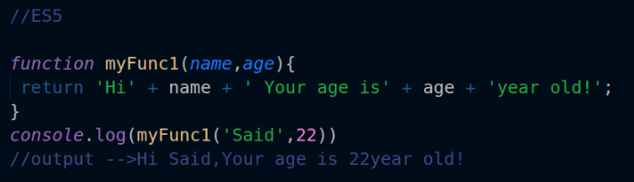
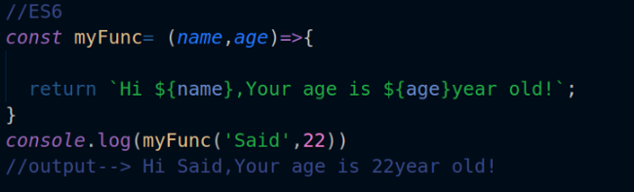
TEMPLATE LITERALS
A new and fast way to deal with strings is Template Literals or Template String. We don’t have to use the plus (+) operator to concatenate strings, or when we want to use a variable inside a string.

Slide 8
DESTRUCTURING ARRAY & OBJECT IN ES6
Destructuring is a powerful way to create variables from values in arrays and objects, It
will make your code simpler. Keep in mind that destructuring is part of the ES2015 (aka
ES6)
Array Destructuring
If you want to assign the values of an array to separate variables, you can take
advantage of destructuring to achieve your goal in a simple, clean way. No need to use
indexes or loops!

Slide 9
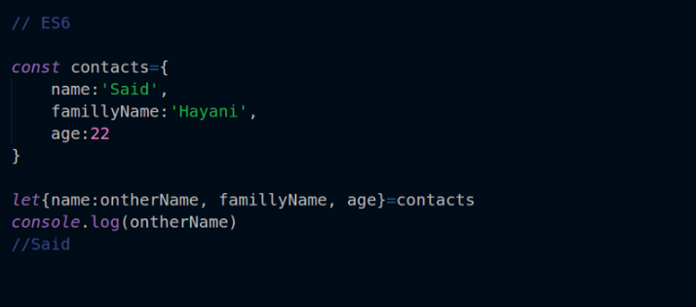

Slide 10
Object Destructuring
We can also use the destructuring assignment syntax to assign object values to
variables. It’s pretty similar to what we did with arrays

Slide 11
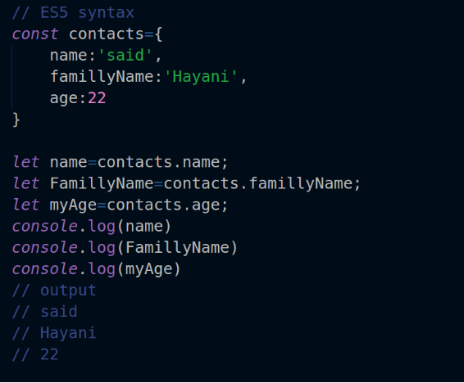
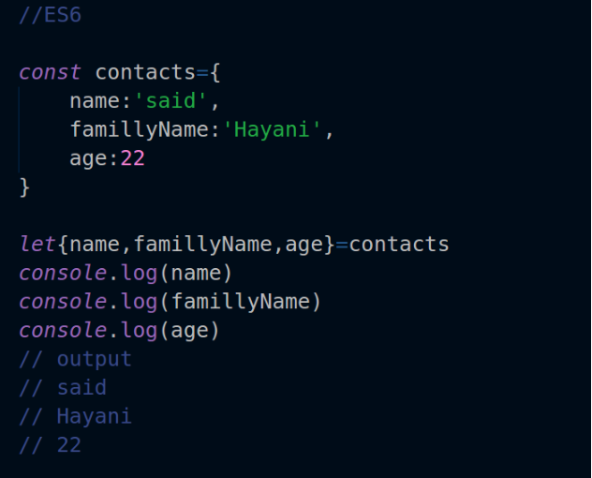

Slide 12
IMPORT & EXPORT KEYWORDS
A module is just a file. One script is one module.
Modules can load each other and use special directives export and import to interchange functionality, call functions of one module from another one:
export keyword labels variables and functions that should be accessible from outside the current module.
import allows the import of functionality from other modules.
Using Import & Export in your JavaScript application makes it more powerful. They allow you to create separate and reusable components.

Slide 13
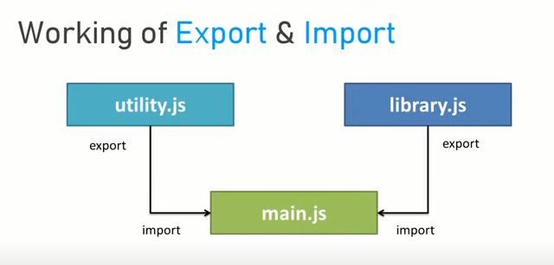

Slide 14
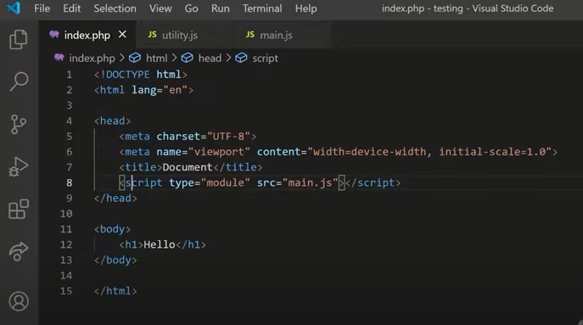
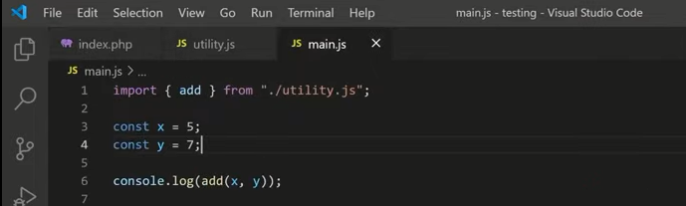
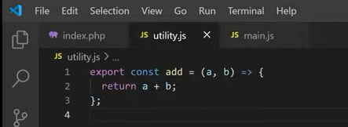

Slide 15
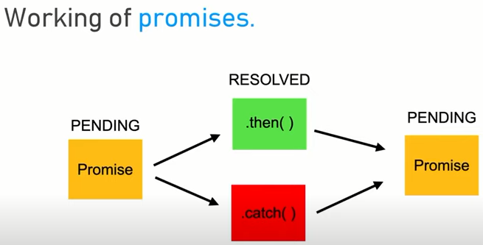
PROMISES IN MODERN JAVASCRIPT
Promises are a new feature of ES6. It’s a method to write asynchronous code. It can be used when, for example, we want to fetch data from an API, or when we have a function that takes time to be executed. Promises make it easier to solve the problem, so let’s create our first Promise!

Slide 16
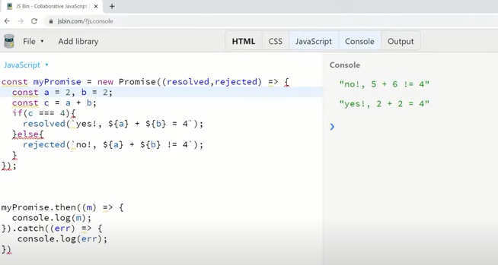

Slide 17
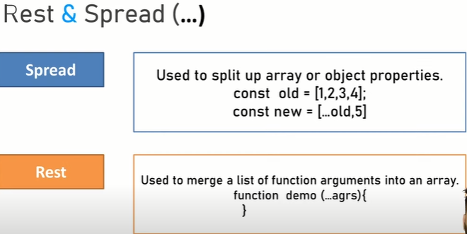
REST & SPREAD OPERATOR
ES6 has some great features that make working with function parameters and arrays extremely easy. Let’s take a look at two of these features: the spread operator and rest parameters.

Slide 18
CLASSES IN JAVASCRIPT ES6
Classes are the core of object oriented programming (OOP). They make your code more secure and encapsulated. Using classes gives your code a nice structure and keeps it oriented.

Slide 19
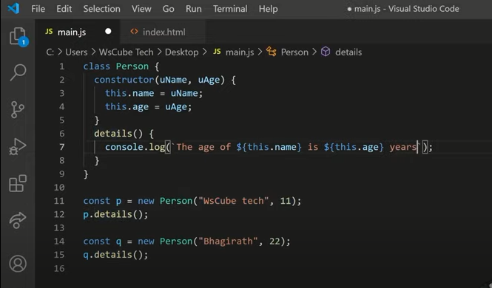

Slide 20
THANK YOU

